Slide 1
Tagging & Tracking Overview
Create, validate, and deploy tracking URLs with confidence — knowing which tags and UTMs your campaigns need right now
GTM Readiness & Performance Teams
June 2026

Slide 2
Module1: Introduction & Overview

Slide 3
This guide is here to help you make sense of creating tracking URLs without any confusion. You'll learn which tags and UTM codes are needed for your campaigns right now. This training will show you how the data you enter every day affects everything else, helping you keep things organized and avoid mistakes that impact strategic marketing reporting.
Purpose
Document Objectives
Outcome
You will gain the confidence to independently build, validate, and deploy flawless tracking URLs across all marketing channels without fear of breaking downstream data. Ultimately, your mastery of these rules ensures that every lead you generate is credited correctly, protecting our fractional attribution and directly empowering our sales teams with the accurate customer context they need to win deals.
Define Core Tracking Rules: Outline the precise criteria for mandatory UTM parameters, defining exact triggers for Workfront automation, Stensul deployment, and manual overrides.
Map Channel Dependencies: Enforce a strict taxonomy matrix detailing standard values for source/medium and identifying the explicit channels where utm_creative is required.
Audit and Educate: Quantify the operational impact of broken tags on downstream reporting, establishing an ongoing validation loop to keep training documentation updated.
Plan
Every field you enter in Workfront or the URL Builder flows into lead credit, fractional attribution, pipeline reporting, and the context sellers see in CRM.

Slide 4
Current State
We currently HAVE to work with a Hybrid Tracking model
Continue capturing legacy IDs because critical operational systems still depend on them.
WE MUST:
1
Simultaneously capture Adobe-friendly tracking parameters because they are the foundation of our future attribution model.
2
Use Workfront automation to bridge both worlds and remove manual effort.
3
The goal is not to replace CCID, DTID, and OID today.
The goal is to capture both legacy and modern identifiers until downstream systems are fully migrated.
On every external URL driving traffic to Cisco.com, include TODAY: • ccid (Activity ID) — campaign initiative; required for lead creation • dtid (Drive To ID) — channel/vehicle that drove the click • utm_id — must equal ccid today (future: Workfront Channel ID) • utm_medium — channel classification (highest priority in analytics) • utm_source — platform or vendor within the channel • utm_creative=%ecid! — only for CM360 Paid Social, Paid Direct, Programmatic Incorrect or missing values break MSP, Adobe, and seller reporting.

Slide 5
Strategic Value of Campaign Tagging & Tracking
Why We Track: Flawless data integrity connects every marketing dollar to real-world sales outcomes—proving ROI, unlocking automated customer journeys, and empowering sellers to win deals.
Optimize Spend
Personalize Journeys
Empower Sellers
Pinpoint exactly which campaigns and channels yield actual closed-won pipeline. Shift budgets in real time from low-intent channels to top-performing initiatives.
Trigger highly targeted, program-specific "always-on" nurture sequences. Deliver hyper-relevant content to the buyer based on precise digital hand-raisers.
Deliver rich, contextual content consumption details to CRM profiles. Help sales reps bypass dry, cold calls to start highly specific, high-value conversations.

Slide 6
Navigating the Hybrid Tracking Landscape
The Constraint
The Friction
The Future State
SFDC lead creation depends on CCID (Activity ID)
Reporting continuity requires: CCID (Activites), DTID (Channels), OID (Content)
Hybrid capture preserves existing dashboards during transition
CCID performs multiple jobs across lead creation and channel activation​
Multi-role IDs distort campaign and touch point reporting​
Manual URL and ID selection creates errors and analytics gaps​
Industry-standard UTMs:
utm_id
utm_medium
utm_source​
Single-purpose Channel IDs and Content IDs​
Workfront automates tracking creation and metadata application, removing human error
Your daily tagging choices → lead records → fractional attribution → seller context → executive reporting

Slide 7
Campaign Tagging & Tracking ID Types
Activity ID
Drive To ID
Offer ID
The Activity ID is the foundational umbrella identifier used to track specific marketing initiatives that generate customer activity in support of global campaigns and programs.
The Drive To ID denotes the specific marketing channel or vehicle being used to direct customers to our digital destinations (such as Cisco.com).
The Offer ID tracks the specific value exchange given to customers to encourage engagement.
Acts as the mandatory trigger for lead generation, entering the scoring program, and adding prospects to nurture journeys.
Tracks the path a user took to get to our site, such as Paid Search or social media platforms.
Monitors the performance of assets or incentives provided to customers in exchange for a specific action, such as filling out a form.
What it Does
Financial Alignment: Every Activity ID must align with a specific cost value in marketing (e.g., an Allocadia budget line item, formal sales requests, or a specific series of events/webinars).
Naming Convention: Names must reflect the specific marketing initiative, including its objective and target audience.
One ID Per Asset: Use exactly one unique Offer ID for a specific asset or offer. Do not create multiple Offer IDs based on the different channels or campaigns driving traffic to that offer.
Sales Enablement (Naming): The offer name serves as a direct signal to sellers; the name must contain enough context for them to use it as a conversation starter.
One-to-Many Relationship: A single Activity ID can be communicated through one or multiple Drive To IDs (e.g., one campaign running across both Facebook and LinkedIn).
Exceptions: Not all marketing vehicles will require a Drive To ID (e.g., offline or non-digital channels like direct audio).
Key Rules
cc0013423
EMEA Band A Digital Marketing - ABX Cross-sell Cloud management solution to Manufacturing Catalyst customers
oemels001119
Owned - Email - Eloqua Campaign Emails
trlsc027054
Cisco Secure Firewall Free Trial Security
Example

Slide 8
Module2: Activity IDs

Slide 9
Operational Impact of an Activity ID
Lead Scoring
Bypasses the scoring model entirely if transactions lack a CCID, blocking vital last-touch details from sellers.
The Engine of Data Integrity
Activity IDs are not just tracking parameters—they are critical systemic requirements that directly drive downstream sales context, automated lead routing, and pipeline reporting accuracy.
Lead Generation
Enforced by system rules in SFDC; leads cannot be generated in the VDC without an active Activity ID.
Program Alignment
Unlocks the mandatory 80% campaign alignment target. Accreditation relies entirely on ID data attributes.
Marketing Journeys
Automatically routes contacts into structured, always-on campaigns or generic journeys using program metadata.
Reporting
Feeds full-funnel pipeline reporting and fractional attribution models to evaluate real-world ROI.

Slide 10
Structure of an Activity ID
1
On Creation of an Activity ID a CCID is automatically generated
CCID
1
cc010898
2
Passed downstream to sellers & must reflect the specific marketing activity used to target the customer.
Information
Name:
Drive engagement and pipeline growth in EMEA Band A mid-market segment relating to Zero Trust Access
Description:
Drive targeted engagement and accelerate pipeline growth within the EMEA Band A mid-market segment. By focusing specifically on Zero Trust Access solutions, the initiative addresses critical security needs for growing organizations across the region. Ultimately, it establishes a strategic framework to capture market share and nurture high-value prospects through dedicated security messaging
2
3
A coordinated, structured set of marketing activities targeted at a specific audience segment to achieve a defined, short-term objective..
Campaign
Campaign
Program
Motion
4
A broader, ongoing strategic framework that encompasses and coordinates multiple related campaigns and initiatives over a longer period.
Future-Proofed Workplaces
Mid Market Networking
Scale
Program
3
4
5
5
How teams target prospects based on personalization level, ranging from high-touch ABM and ABX to broad-reach Scale Marketing
Motion

Slide 11
Create an ID for Each of your Initiatives
cc010898
cc010912
Name:
Drive engagement and pipeline growth in EMEA Band A mid-market segment relating to Zero Trust Access
Description:
Drive targeted engagement and accelerate pipeline growth within the EMEA Band A mid-market segment. By focusing specifically on Zero Trust Access solutions, the initiative addresses critical security needs for growing organizations across the region. Ultimately, it establishes a strategic framework to capture market share and nurture high-value prospects through dedicated security messaging
Name:
AMER Mid-Market Secure Campus & Branch Connect
Description:
This campaign focuses on driving engagement and pipeline growth within the Americas mid-market segment by highlighting secure campus and branch networking solutions. It addresses the critical need for midsize businesses to deploy scalable, robust, and highly secure infrastructure across distributed office environments. Through targeted messaging, the initiative aims to accelerate the sales cycle and capture expanding network security opportunities across the region.
Campaign
Program
Motion
Campaign
Program
Motion
Future-Proofed Workplaces
Mid Market Networking
Scale
Future-Proofed Workplaces
Mid Market Networking
Scale
cc010918
cc01102
Name:
EMEA Enterprise AI-Driven Network Assurance (Powered by ThousandEyes)
Description:
Driving adoption of AI-powered network assurance and visibility across the EMEA market by showcasing the native integration of Thousand Eyes with Cisco networking hardware. It highlights how organizations can leverage deep, granular insights across their entire digital infrastructure to proactively isolate performance bottlenecks and drastically reduce mean time to repair (MTTR).
Name:
Global Enterprise: Unified Defense Framework for Neocloud Security
Description:
This campaign introduces a comprehensive, layered security framework designed to embed robust protection across the Management Plane, Perimeter, Fabric, and Workload layers of Neocloud environments. By highlighting the integration of Cisco Secure Firewall, the initiative showcases how enterprise organizations can achieve high-performance macrosegmentation and advanced threat defense across their entire digital ecosystem.
Campaign
Program
Motion
Campaign
Program
Motion
Future-Proofed Workplaces
Up Market Networking LDOS
Scale
AI-Ready Data Centers
Neocloud
Scale

Slide 12
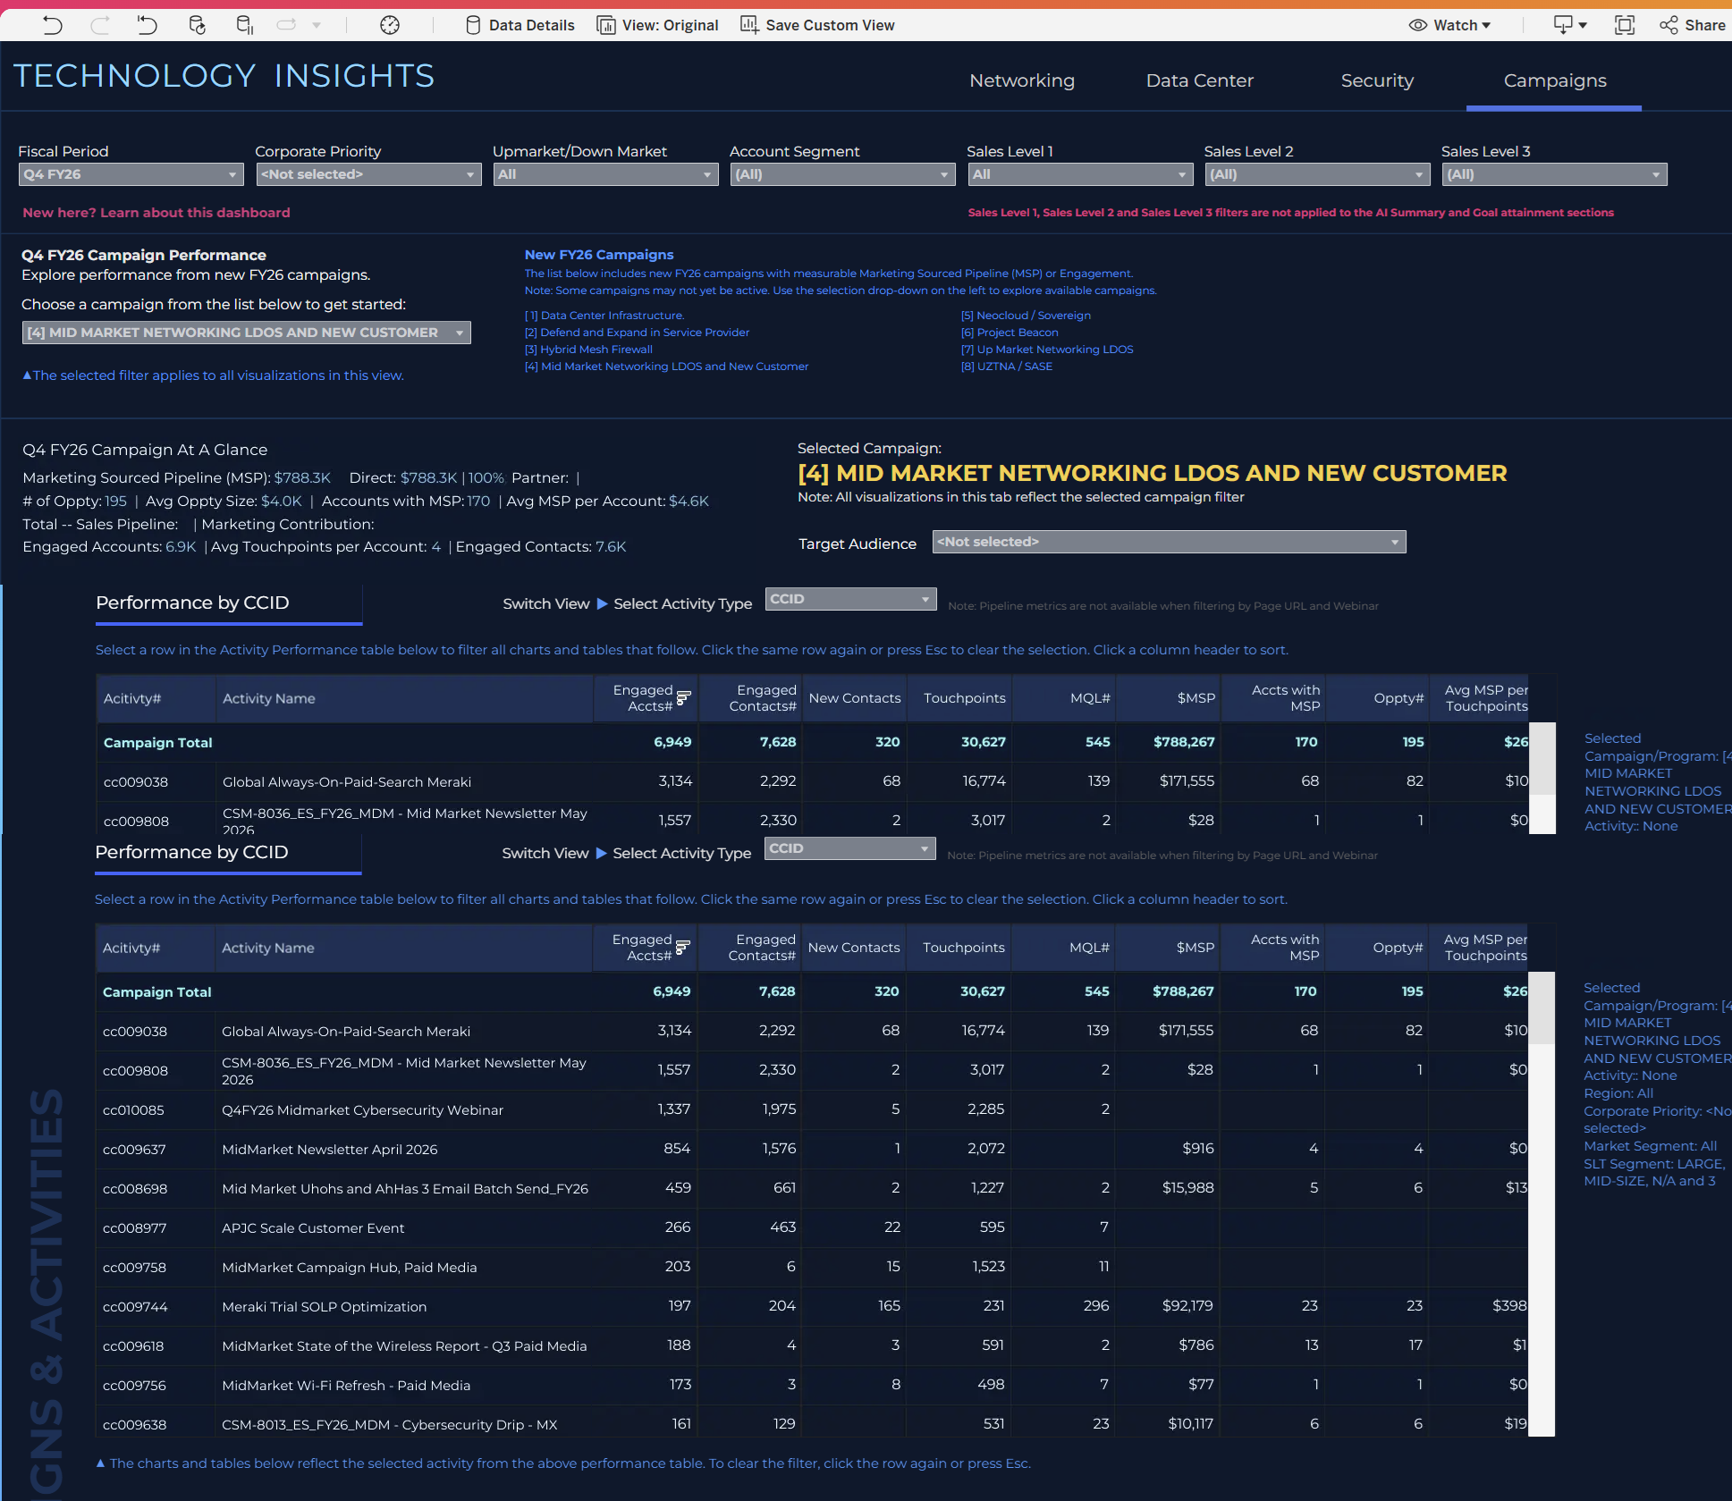
Technology Insights Reporting
1
Data is strictly limited to campaigns aligned with the FY26 strategic framework.
Framework
2
Selecting a campaign instantly updates the entire tab to show its specific performance results.
Dynamic
3
Engagement and pipeline metrics are automatically derived from tracking IDs (CCID, OID, EID) mapped via tagging metadata.
ID Driven
4
Includes all pipeline impacted by campaign-linked activities, even if it falls outside the core target product mix.
Pipeline
5
This view isolates the exact engagement and pipeline generated by your selected campaign's tracking tags.
Bottom Line
Best Used to Answer:
How did a specific campaign (e.g., Mid Market LDOS) perform end-to-end?
Which specific activities, offers, and events successfully drove engagement and pipeline for this campaign?
Tech Insights

Slide 13
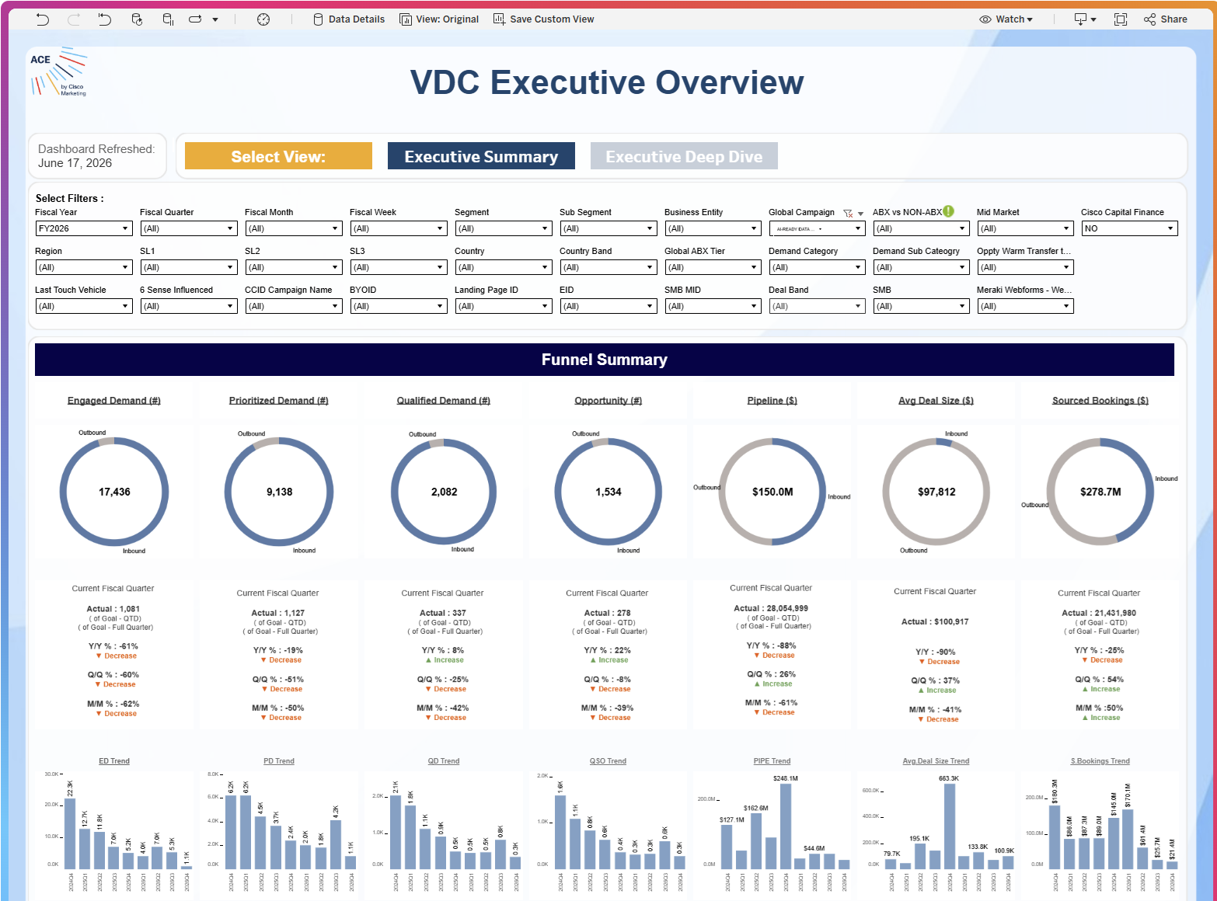
VDC Executive Overview
1
Tracks core marketing performance metrics across the entire lifecycle
Funnel
2
Real-time performance against quarterly goals alongside year-over-year (Y/Y), quarter-over-quarter (Q/Q), and month-over-month (M/M) growth trends.
Goals
3
The entire Funnel Summary can be sliced by specific tagging IDs, allowing teams to isolate the exact impact of specific marketing initiatives.
Filtering
4
Inbound vs Outbound
break down volume and revenue metrics by traffic type (Inbound vs. Outbound)
Why CCID Filtering is Possible:
Because the CCID (Campaign Control ID) is captured system-wide at the lead level, it embeds key campaign and program data directly into the lead record. This metadata acts as the connective tissue that allows the dashboard to instantly filter and attribute downstream revenue, bookings, and pipeline back to the originating marketing campaign.
VDC Executive Overview

Slide 14
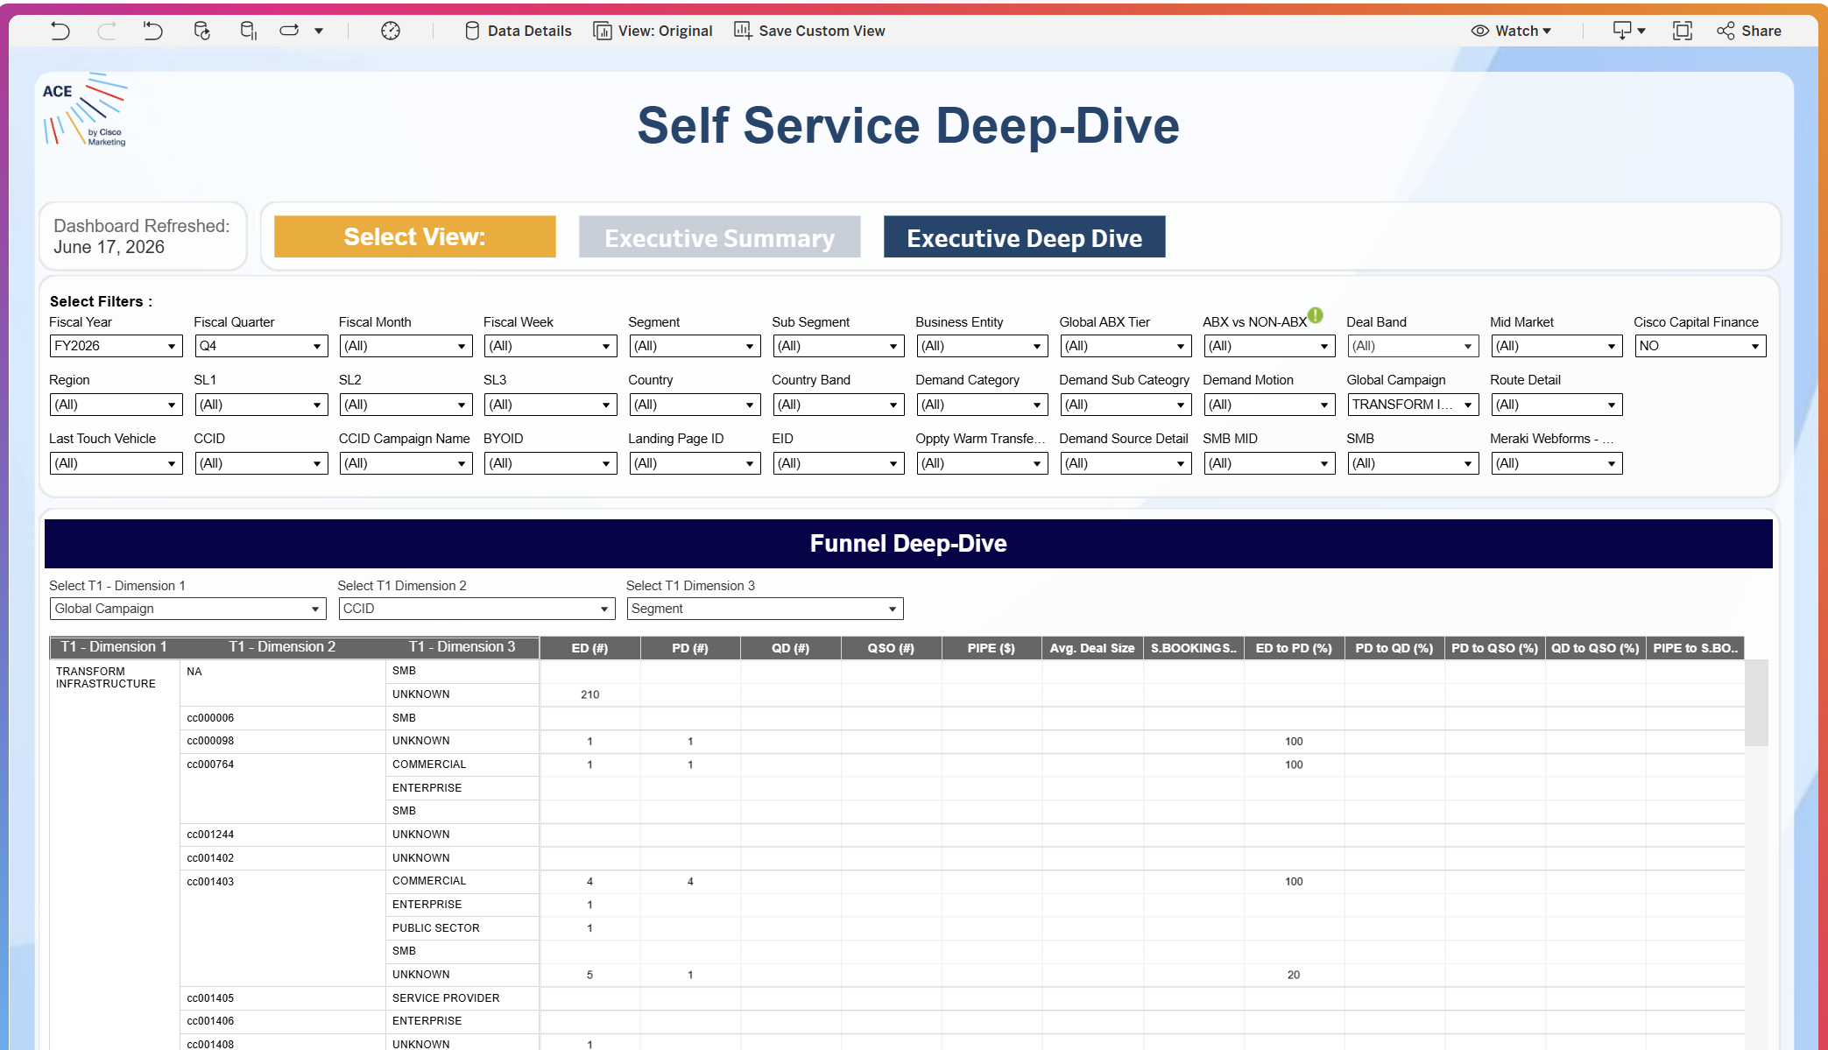
Self Service Deep Dive
1
Data is strictly limited to campaigns aligned with the FY26 strategic framework.
Framework
2
Selecting a campaign instantly updates the entire tab to show its specific performance results.
Dynamic
3
Engagement and pipeline metrics are automatically derived from tracking IDs (CCID, OID, EID) mapped via tagging metadata.
ID Driven
4
Includes all pipeline impacted by campaign-linked activities, even if it falls outside the core target product mix.
Pipeline
5
This view isolates the exact engagement and pipeline generated by your selected campaign's tracking tags.
Bottom Line
Best Used to Answer:
How did a specific campaign (e.g., Mid Market LDOS) perform end-to-end?
Which specific activities, offers, and events successfully drove engagement and pipeline for this campaign?
Self Service Deep Dive

Slide 15
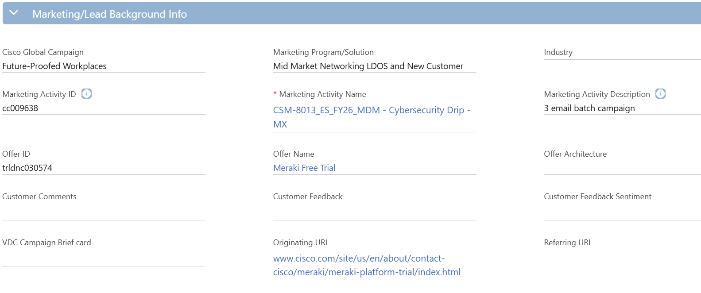
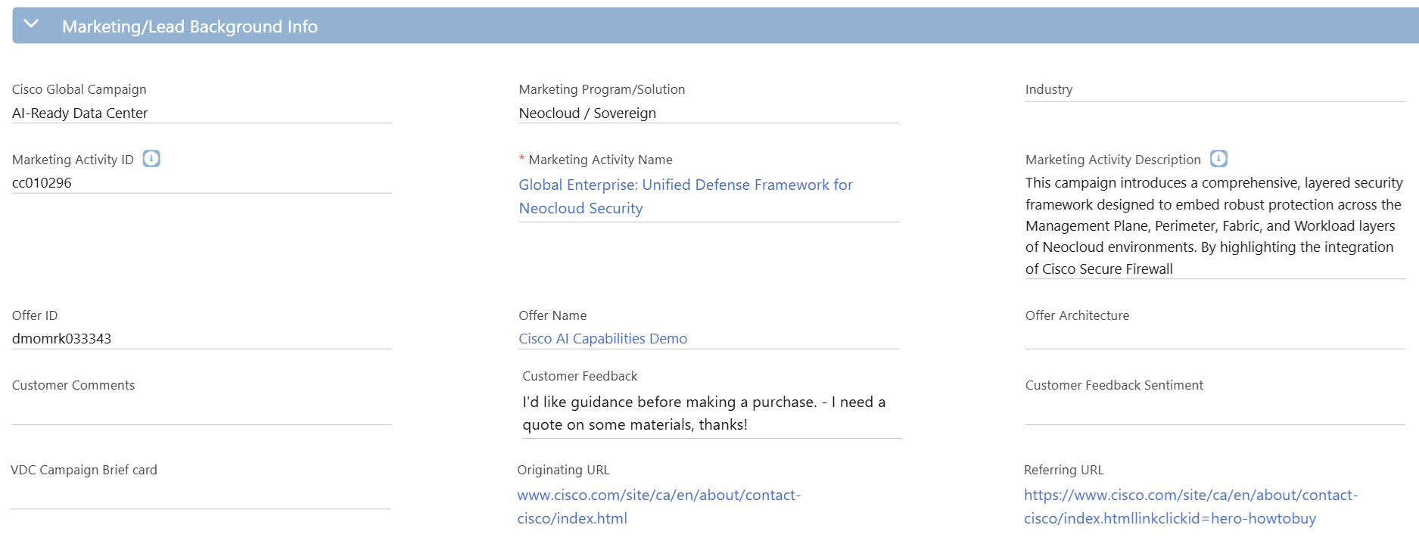
Seller Enablement
Bad Example
1
Avoid acronyms they don’t translate well for the sellers and inhibits the lead conversation a name should immediately explain to the seller the marketing initiative the customer has engaged with.
Names
1
2
2
Craft marketing initiative descriptions with the sales team in mind—not marketing—by explicitly including the target audience and core objective to provide sellers with actionable context for customer conversations.
Description
Good Example
3
Originating URL
Captures the exact webpage hosting the call-to-action (CTA) trigger that the user clicked to access a gated offer.
1
2
4
Captures the specific URL of the consumed gated offer, serving as a live hyperlink that sellers can click to view and understand the exact content the customer interacted with.
Referring URL
3
4

Slide 16
Module 3: Drive To & Offer IDs

Slide 17
Structure of a Drive To ID
The Traffic blueprint
The Drive To ID serves as a standard, reusable taxonomy blueprint that explicitly defines the target audience, messaging, and execution channel. By providing the foundational data required for channel-level operational reporting, it optimizes marketing spend for maximum ROI while powering both the HVE and MSP reporting frameworks to accurately credit the digital entry points driving customer action.
1
On Creation of an Drive To ID a DTID is automatically generated
DTID
2
Standardized naming convention of Type – Vehicle – Short Name
Description
3
Paid (sponsored), Owned (internal databases), or Earned (organic reach). Optimizing specific content delivery.
oemels001119
1
Audience
2
Description:
Owned - Email - Eloqua Campaign Emails
4
Standardizes the specific communication channel utilized (Email, Paid Social, Display). Ensuring clean normalized performance comparisons across channels.
Vehicle
Type
Vehicle
Vendor
Owned
Email
Eloqua
5
Identifies the exact execution technology or publisher platform. This enables pinpoint tactical analysis of partner-level efficiency and ROI.
Vendor
3
4
5

Slide 18
Structure of an Offer ID
The Asset blueprint
The Offer ID serves as a standard, asset-specific taxonomy blueprint that explicitly defines the high-value gated content, experiences, and incentives consumed by our customers. By embedding rich, descriptive context directly into the lead record, it arms sales teams with the immediate intelligence needed to initiate highly targeted conversations while fueling downstream product marketing analytics to isolate and scale our highest-converting digital assets.
1
Automatically generated code that uniquely tracks this asset across all digital systems.
OID
2
Breaks down the specific features or solutions covered to provide the seller with actionable context.
Description
3
Categorizes the delivery format of the asset—such as a Demo, or Webinar—allowing marketing teams to analyse which types of gated experiences convert best.
dmomrk033343
1
Type
Name:
Cisco AI Capabilities Demo
Description:
Primarily: AI Canvas, AI Assistant, and Agentic Ops as an overall concept/solution
2
4
Language
Denotes the localized language version of the asset, ensuring accurate global reporting.
Type
Language
Activity ID
Demo
English
cc009328
5
The Activity ID that links this specific offer back to its parent marketing program ensuring lead generation and pipeline metrics are credited correctly
Activity ID
3
4
5

Slide 19
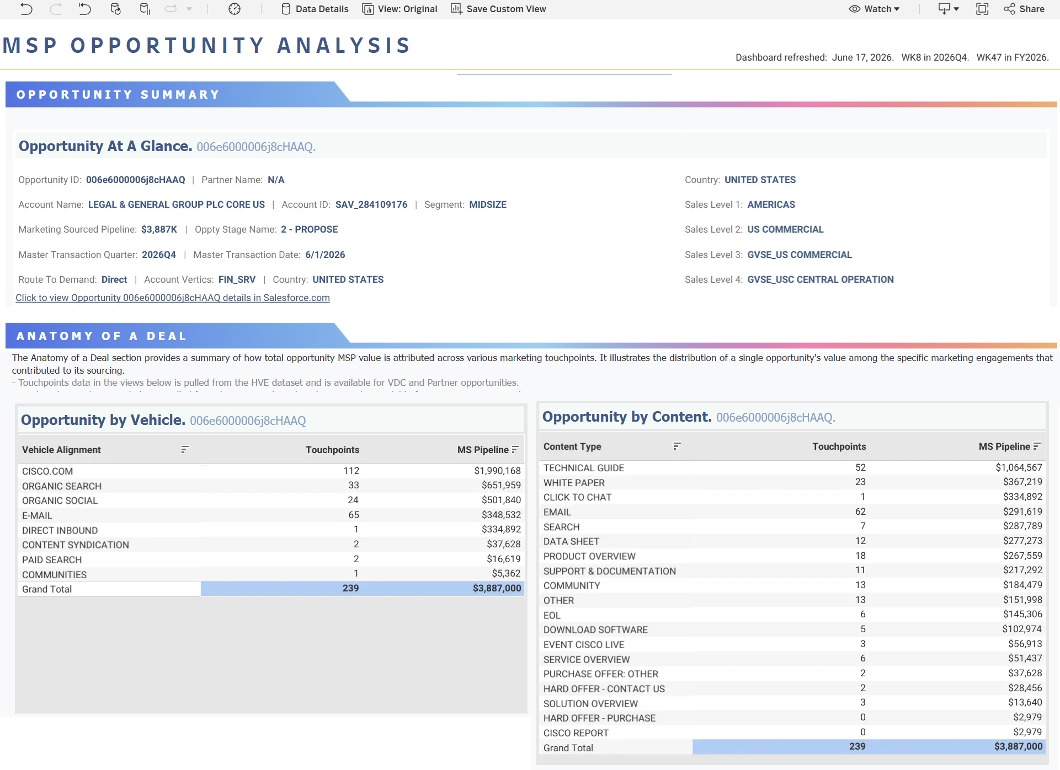
Anatomy of a Deal
1
Channel Performance
A single deal can contain multiple touchpoints, correct Drive To IDs ensure that every interaction is accurately bucketed into its specific channel vehicle
2
Asset Attribution
Capture the assets driving the deal &maps the specific marketing asset to the touchpoint, showing what content types are influencing the pipeline and yielding return.
3
Touchpoint data for the HVE dataset aligns to Offer & Drive To IDs
HVE
4
MSP
Ties touchpoints to an actual dollar value, clean data mapping demonstrates impact on revenue.
5
Budget
Anatomy of a deal show us which combinations of vehicles & content deliver the most cost-effective path to conversion
Anatomy of a Deal

Slide 20
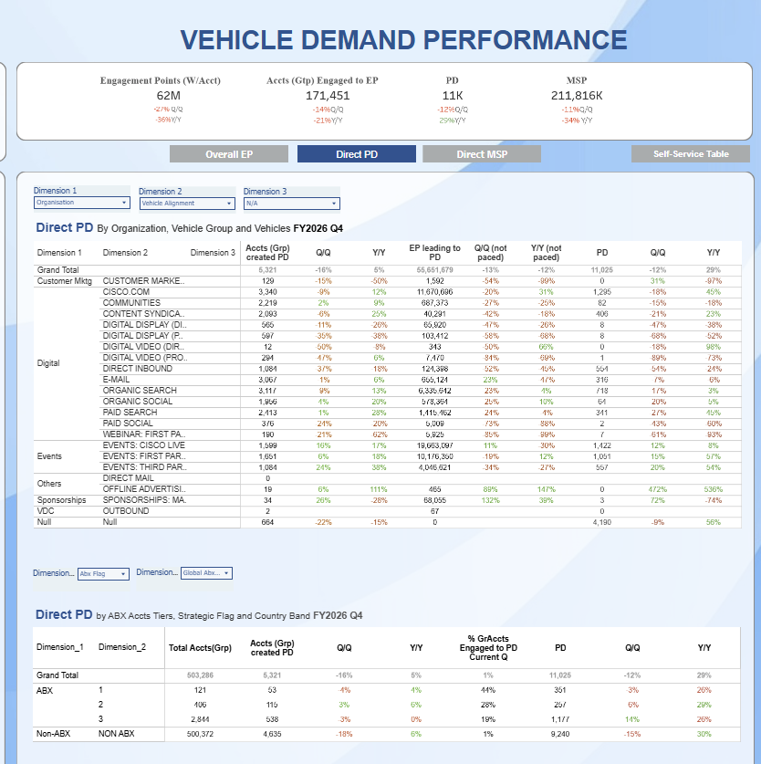
Vehicle Demand Performance
1
Fair Credit
Correct setup and use of DTID ensures teams receive accurate, proportional credit for every engagement and dollar of pipeline
2
Account Penetration
Provides feedback on how effectively targeted plays are penetrating high value Tier 1, 2 & 3 accounts showing the success of ABM, ABX strategies
3
Shows the percentage of the channel traffic coming from high-priority accounts vs. anonymous web traffic, to drive more defined targeting parameters.
Budget Waste
4
Growth
Q/Q & Y/Y reporting in relation to vehicles allows us to track upward growth trends to justify scaling successful programs
5
Defend
Budget
Provides the accurate data to defend budget and secure funding for future initiatives
Vehicle Demand Performance

Slide 21
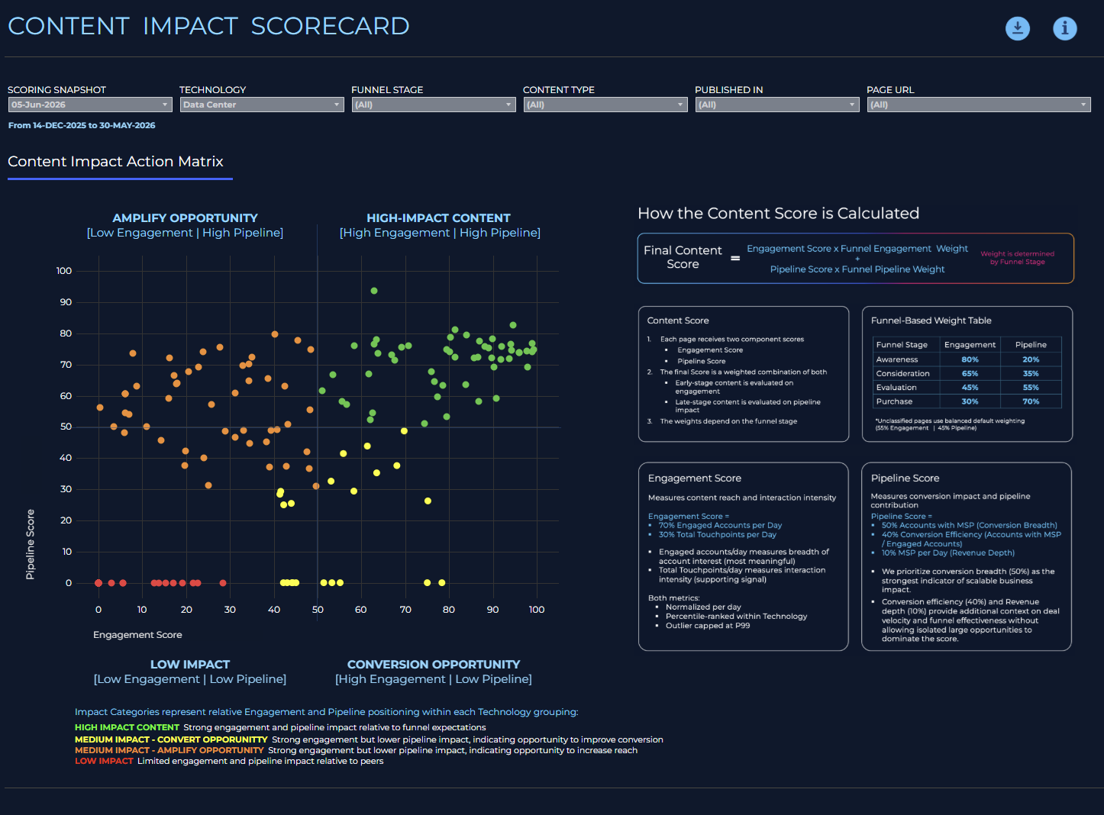
Content Impact Scorecard
1
Optimize
Mapping content by pipeline vs engagement we get a roadmap as to what to do such as amplify opportunity for low-engagement/high pipeline content etc.
2
Funnel Stage
Teams benefit from a scoring system that understands the user journey where we can monitor traffic by awareness, consideration and evaluation
3
Shows how content contributes to the bottom line by measuring “Conversion Breadth” and “Revenue Depth” to see what collateral is closing deals
Revenue
4
Retirement
Shows underperforming assets into a red bucket Signalling outdated web pages and content that should be decommissioned
Content Impact Scorecard

Slide 22
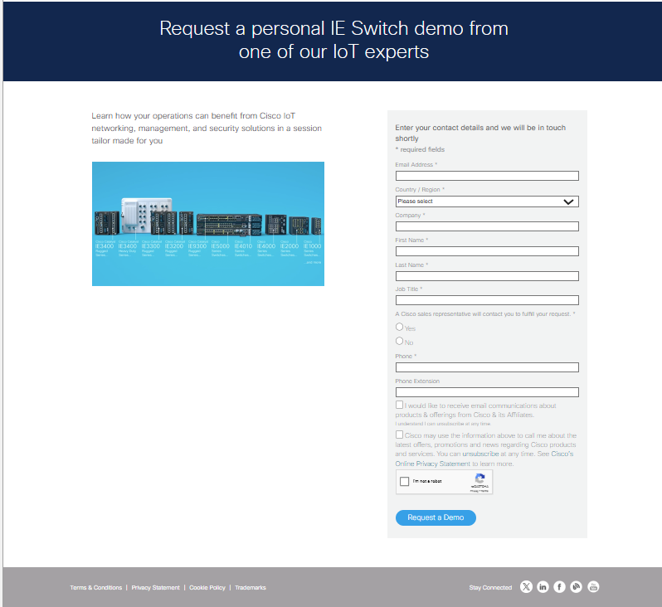
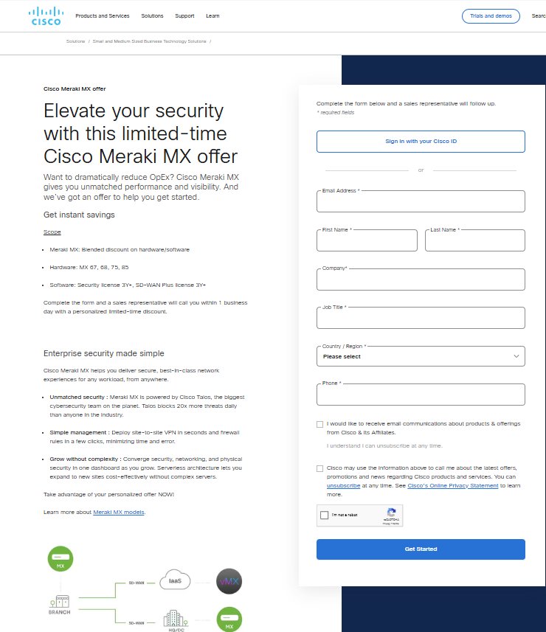
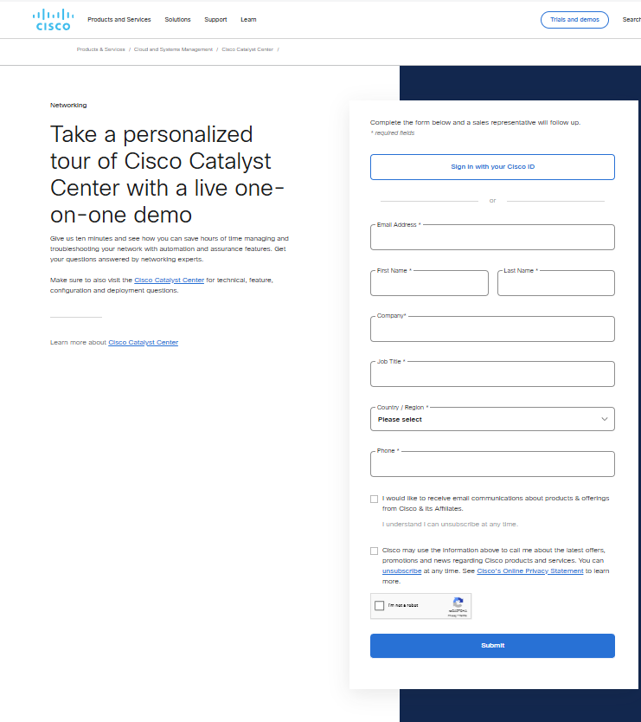

ID Relationships
Activity ID
(What Marketing Initiative am I promoting)
Activity ID
Activity ID
Activity ID
cc010898
cc010912
cc011102
Drive To ID
(How am I getting the message to my customer)
Drive To ID
Drive To ID
Drive To ID
oemels001119
psexsp001647
psoins001233
Eloqua Email
Google Paid Search
Insta Paid Social
Offer ID
(What am I giving my customer in return for a sales follow up and their contact details
dmoit029445
podmrk031943
otren015026
wbrsas031944

Slide 23
Why Legacy Tracking is No Longer Enough
The Core Dilemma:
The CCID was designed for a single job—capturing the marketing initiative. Forcing it to handle lead scoring, events, and as a primary identifier for lead generation breaks data trust.
Data Ambiguity
Attribution Skew
Platform Incompatibility
Mixed ID usage creates untrustworthy reporting rows
Forcing a single identifier to fulfil multiple operational roles makes it impossible to verify whether an ID was deployed correctly or what specific customer action it represents.
Double-duty keys distort revenue and touchpoint models.
Using one ID across disparate channels and campaign types skews engagement counts, inflates touchpoints, and distorts top-of-funnel campaign performance metrics.
Legacy keys fail to connect natively with Adobe North Star platforms.
External media partners and agencies must be specially trained on internal Cisco code rules rather than using industry-standard tracking protocols.

Slide 24
Module 4: UTM Tagging

Slide 25
Strategic Value of UTM Tracking
Why We Track: We want to modernise our digital marketing tracking through strict data standardization and automation of tracking parameters to be able to derive data-driven insights for performance understanding
Tool Integration
Scalability
Self Service Query
Major analytics platform engines (like Adobe Analytics and Google Analytics) natively recognize UTM parameters without custom backend programming or data mapping scripts.
External ad networks, marketing automation platforms, and programmatic software easily pass and digest UTM strings natively, eliminating data drop-offs between our platforms.
UTMs are the universal language of web analytics, any future software we add to our marketing technology stack will instantly understand our historical traffic data.
Allows external media partners, agencies, and global teams to seamlessly deliver standardized tracking URLs without needing custom training on Cisco-exclusive code frameworks.
Analysts can instantly build reports using standard dimensions like utm_source or utm_medium across web platforms, without needing complex SQL joins or specialized internal tools to look up what a custom ID means.

Slide 26
UTM Tracking ID Types
UTM ID
UTM_MEDIUM
UTM_SOURCE
UTM_CREATIVE
The utm_id captures a universal identification key that carries pertinent data attributes into reporting tools.
the utm_medium denotes the overarching high-level marketing vehicle or channel method used to distribute the message.
The utm_source identifies the specific tactical platform, sub-vehicle, web property, or vendor that sent traffic to the campaign destination.
The utm_creative parameter captures creative-level identifiers linked directly to ad-serving infrastructure
Passes the unique tracking string into the analytics platform to bridge digital traffic data with campaign attribution systems.
Drives the core channel classification layer in reporting, allowing marketers to evaluate the comparative performance of broad deployment methods.
Breaks down channel data into granular vendor-level performance metrics, clarifying which platforms drive visitors effectively.
racks user clicks down to the exact ad variation, enabling creative-level optimization and performance diagnostics within downstream analytics.
What it Does
System Alignment: Must equal the ccid value exactly—they are the same underlying identifier passed in two separate ways on the URL string.
Global Formatting: Must always be lowercase and use hyphens instead of spaces if any text elements are ever included.
Highest-Priority Field: This is the highest-priority taxonomy input for macro channel classification across reporting dashboards.
Standardized Values Only: Users must strictly select from the pre-approved list of lowercase, hyphenated values (e.g., paid-social, cpc, email).
Channel Dependency: The available dropdown values in Workfront dynamically render based on the parent Channel Type selected by the user.
Taxonomy Formatting: Maps the user-selected friendly label to a lowercase, hyphenated string for consistent reporting rows.
Channel Restrictions: Only required and populated for three specific project types: Direct Media, Programmatic Media, and Paid Social. Omit entirely for other channels.
Macro Token Automation: Automatically appends the static %ecid! macro token, which CM360 replaces with a 9-digit ad-server ID upon a live click.
Key Rules
Example
utm_id=cc008317 (where ccid=cc008317)
utm_medium=paid-social
utm_source=linkedin
utm_source=linkedin
NB:. Workfront Integration Roadmap: When Workfront releases the capability to capture Workfront Channel IDs, the UTM_ID will adopt that value to replace the CCID. The release date is currently to be confirmed, and training documentation will be updated accordingly.

Slide 27
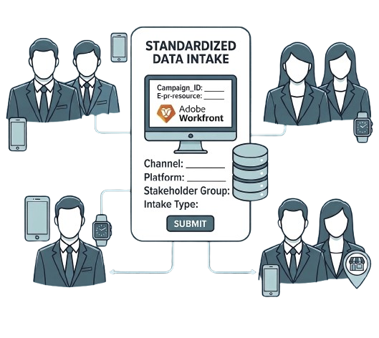

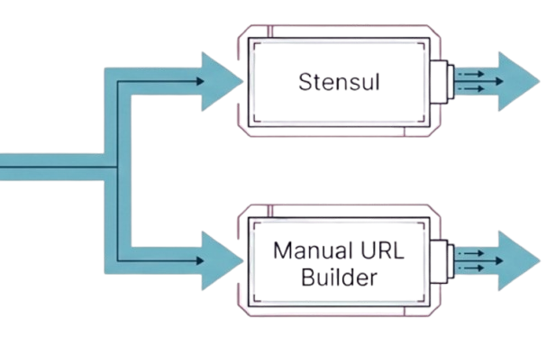
Empowering the Automation Engine Via Workfront
Centralized Intake
Eliminating Manual Error
Platform Parity
TEAM A
Global Media
TEAM B
Field Marketing
TEAM C
Integrated Marketing
Execution Teams may use different platforms, but all must strictly apply the exact same underlying tagging rules dictated by Workfront
Workfront is the absolute source of truth for campaign intake
Upon submission, Workfront reads intake form fields to auto-generate the complete Tracking URL

Slide 28
Dissecting the Hybrid URL Requirements
TODAY (FY27): utm_id must match ccid on every live URL. FUTURE preview only — do not deploy until governance confirms: utm_id=CHL000093 with ccid/dtid retired.
https://www.cisco.com/site/us/en/about/why-cisco/ai-ready-data-centers/index.html?ccid=cc010375
&dtid=pdixsp001642
&utm_id=cc010375
&utm_medium=paid-direct
&utm_source=businessinsider&utm_creative=%ecid!
Activity ID
Drive To ID
UTM ID
UTM MEDIUM
UTM SOURCE
UTM CREATIVE
Legacy Marketing Initiative Activation
Legacy Channel Type
Modern Marketing Initiative Activation (currently CCID , but will move to Workfront ID)
Modern Channel Capture
Modern Traffic Vendor/Platform
Ad-Server Creative ID
(Global Media Team Only)
Parameters start after the destination URL with a ? And are separated by the & symbol with all values lower case
Validate before launch: utm_id = ccid · all values lowercase · no Offer ID on inbound URLs

Slide 29
Module 5: Workfront IDs

Slide 30
Strategic Value of Workfront IDs
Why We Track: Standardizing intake through Workfront ensures every marketing activity is automatically tagged at the point of request, protecting data integrity and simplifying downstream reporting
Centralized Intake
Automated Solution
Scalable Reporting
Leverages Workfront as the standard, automated intake solution for all campaign activations across digital channels. This approach, built entirely within the unified Adobe ecosystem, consolidates all project requests into one governed pipeline.
Establishes a governed, central repository where precise data elements are appended to the Workfront ID. This locks the taxonomy matrix required to power all downstream channel-level operational reporting, executive overview metrics, and flawless fractional attribution models.
Guarantees absolute accuracy by automating the generation and construction of complex tracking URLs, including the mapping of standardized utm_medium and utm_source values. This systemic flow completely removes manual intervention and human error from the URL building process.

Slide 31
Workfront ID Types
Project ID
Channel ID
Content ID
The Project ID is the umbrella identifier for an overarching marketing initiative created within Workfront,
The Channel ID denotes a unique, specific marketing execution vehicle that is automatically generated within a Workfront project
The Content ID is a task-level identifier nested under the Project ID that tracks specific customer-consumed assets
This identifier does not appear on any external-facing URLs. Instead, it serves as the foundational data link that connects all associated tasks back to the single, comprehensive campaign initiative
Today: Workfront auto-generates ccid, dtid, and UTMs — utm_id on the live URL must equal ccid. Future: Workfront Channel ID will populate utm_id once governance confirms go-live.
The Content ID ensures that all customer interactions with an asset (touches) are accurately aligned with the master marketing initiative (the Project) for fractional attribution and touchpoint analytics
What it Does
Operational Link: All individual campaign activations (Channel IDs) and related gated assets (Content IDs) must be nested under one Project ID to guarantee integrated performance reporting.
URL Usage: Do NOT use the Project ID on any external query strings (UTM parameters); its usage is strictly internal to maintain data taxonomy.
Unique Execution Key: Create one (and only one) Channel ID per specific platform activation. If a project deploys two emails and one social post, three distinct Channel IDs must be generated.
UTM Integrations: The system uses the information associated with the Channel ID to automatically map standardized utm_source and utm_medium values to the query string
Content and Page Mapping: The Content ID must be appended to the specific Adobe Experience Manager (AEM) page where the content is hosted.
Multi-Offer Support: A single Project ID can contain multiple Content IDs. For example, one campaign can offer a white paper and a free trial simultaneously.
Key Rules
PA000120
web_pa_Build Your Practice - Global Subpage_gl_fy26_07_6586992 (23)
CHL000100
SecureCampus-ContainThreats_PSRD
CON001089
customer story or case study-banco do brasil (portuguese) customer story-us-en
Example

Slide 32

Structure of a Channel ID
Channel ID
automatically generated at channel task creation. Today it maps to ccid on your URL; in future it will populate utm_id directly.
CHL000093
Channel Type
The Channel that drove the customer to .com
Name:
AMER Q3 AI Networking Launch Invites
Channel Sub-Type
Granular information relating to the Channel Type
Channel Type
Channel Sub Type
Channel Platform
Channel Platform
The specific platform, vendor, or site where the link was placed within the medium
Email
Event Invitation
Marketo
Technology
Defines the core IT infrastructure being targeted
Technology
Campaign
Program
Campaign
A coordinated, structured set of marketing activities targeted at a specific audience segment to achieve a defined, short-term objective.
Data Centre
Full-Stack AI Infrastructure
Full-Stack AI Infrastructure - Industry Vertical
Program
A more granular framework that encompasses and coordinates multiple related campaigns and initiatives over a longer period.
Stakeholder
Language
Funnel Stage
Integrated Marketing
US_EN
Consideration
Stakeholder
The specific team that initiated the marketing initiative
Language
The country and language code the initiative is being executed in
Funnel Stage
A step in the customer journey that categorizes prospects based on their level of awareness, intent, and readiness to purchase.

Slide 33
Structure of a Content ID
Content ID
On Creation of Workfront Content Task a Content ID is automatically generated and appended in the HTML of an AEM Page
CON004547
Content Type
The type of Content that is being created
Name:
Webinar: Inception to Innovation: The Evolution of AI
Description:
We delve into the fascinating journey of artificial intelligence from its historical roots to its current transformative role in business and industry
Content Sub-Type
Granular information relating to the Content Type
Content Type
Content Sub Type
Content Platform
Content Platform
The specific platform, vendor, or site where the content was placed
Webinar
Test Drive
Cisco.com
Technology
Campaign
Program
Tech/Campaign/
Program
The technology, campaign and program the content is aligned to that is used for content attribution models
Data Centre
Full-Stack AI Infrastructure
Full-Stack AI Infrastructure - Industry Vertical
Same standard values as the Channel, but aligned directly to the conent
Stakeholder/
language/funnelstage
Stakeholder
Language
Funnel Stage
First or Third Party run webinar (only valid when Content Type = Webinar)
Webinar Owner
Integrated Marketing
US_EN
Consideration
Webinar Status
The specific type of webinar being published (Live, simu-live, On-Demand)
Webinar Owner
Webinar Status
Date
First Party
Simulive
17/09/2026
Date
Date the Webinar is published

Slide 34
Module 6: When to use your IDs
From this module you will be able to choose the right IDs, build the URL, and validate it before launch — so every lead is credited correctly and sellers receive accurate customer context.
Choose IDs (Legacy · UTM · Workfront) → Build URL (Workfront first; Manual URL Builder if needed) → Validate checklist → Deploy

Slide 35
When to Use your Legacy IDs
Use Case
CCID
DTID
OID
EID
Comments
Appended to any URL that is driving Traffic to .com such as an email, paid search, social link, traffic from an external site | ✓ | ✓ | ✗ | ? | External Inbound URLs: Offer IDs must never be appended to inbound URLs. Event IDs are optional and link inbound traffic data directly to Meeting Request Form (MFR) submissions.
Cisco.com call to actions or page links | ✗ | ✗ | ✗ | ✗ | Internal Site Links: Never append tracking IDs to internal cisco.com links. Tracking IDs are strictly reserved for external marketing initiatives driving traffic to cisco.com.
Landing Pages containing a Gated Offer | ✗ | ✗ | ✓ | ✗ | Gated Offer Pages: Offer IDs are used exclusively on gated pages and captured via marketing automation form submissions to measure offer consumption and asset performance.
Manual Uploads via the MUSE Template | ✓ | ✓ | ? | ? | Manual Lead Uploads: CCID is mandatory for SFDC lead creation. DTID identifies acquisition channel. Include Offer ID when the upload relates to a specific gated asset; Event ID when tied to an event/MRF.
Content Syndication via Integrate | ✓ | ✓ | ✓ | ✗
Pathfactory Registraitons | ✓ | ✓ | ✓ | ? | PathFactory Registrations: CCID, DTID, and Offer ID required in integration payload. Event ID optional — use when linking to event/MRF context.
BrightTalk Integration | ✓ | ✓ | ✓ | ? | BrightTalk Integration: CCID, DTID, and Offer ID required. Event ID optional for webinar/event linkage.

Slide 36
When to Use your UTM IDs
Use Case
ID
MEDIUM
SOURCE
CREATIVE
Comments
Appended to any URL that is driving Traffic to .com such as an email, paid search, social link, traffic from an external site | ✓ | ✓ | ✓ | ? | TODAY (FY27): Every external URL needs ccid, dtid, utm_id (= ccid), utm_medium, and utm_source. Add utm_creative=%ecid! for CM360 Paid Social, Paid Direct, and Programmatic. FUTURE: utm_id will adopt Workfront Channel ID.
Cisco.com call to actions or page links | ✗ | ✗ | ✗ | ✗ | Not Applicable (Internal Links): UTM parameters are strictly reserved for external inbound traffic to cisco.com. Never use UTMs on internal page links or CTAs.
Landing Pages containing a Gated Offer | ✗ | ✗ | ✗ | ✗ | Not Applicable (On-Page Forms): UTM parameters are captured at entry via external URLs, not applied directly to landing page forms or offer assets.
Manual Uploads via the MUSE Template | ✗ | ✗ | ✗ | ✗ | Not Applicable (Offline Lead Ingestion): UTM parameters measure digital inbound web traffic and are not utilized in MUSE offline lead uploads.
Content Syndication via Integrate | ✗ | ✗ | ✗ | ✗ | Not Applicable (Syndicated Leads): Integrate lead ingestion relies on core campaign IDs (Activity, Drive To, Offer) rather than inbound UTM parameters.
Pathfactory Registrations | ✓ | ✓ | ✓ | ✗ | PathFactory Registrations: Same hybrid URL rules as other inbound traffic — utm_id must equal ccid today; utm_medium and utm_source required.
BrightTalk Integration | ✗ | ✗ | ✗ | ✗ | Not Applicable (Webinar Lead Ingestion): BrightTalk lead imports utilize core tracking IDs rather than inbound web UTM parameters.

Slide 37
When to Use your Workfront IDs
Use Case
Channel
Content
Comments
Appended to any URL that is driving Traffic to .com such as an email, paid search, social link, traffic from an external site | ✓ | ✗ | TODAY: Workfront creates Channel ID at intake and auto-builds the hybrid URL (ccid + dtid + UTMs). Do not manually paste Channel ID into utm_id — the live URL uses utm_id=ccid. FUTURE: Channel ID will populate utm_id.
Cisco.com call to actions or page links | ✗ | ✗ | Not Applicable (Internal Links): Workfront IDs are strictly for external marketing initiatives and must never be appended to internal site links or CTAs.
Landing Pages containing a Gated Offer or Non-Gated Offer | ✗ | ✓ | Content Experience Tracking: The Workfront Content ID is added to all AEM pages. It will eventually replace the Offer ID, enabling content attribution in MSP and tracking non-gated asset consumption (previously unsupported by legacy IDs).
Manual Uploads via the MUSE Template | ✗ | ✗ | Out of Scope: Workfront ID integration is not currently supported for manual MUSE lead uploads.
Content Syndication via Integrate | ✗ | ✗ | Out of Scope: Workfront ID integration is not currently supported for third-party Integrate syndication.
Pathfactory Integrations | ✓ | ✗ | PathFactory: Workfront Channel ID links the experience to your project for MSP reporting. URL still uses utm_id=ccid today.
BrightTalk Integration | ✗ | ✗ | Out of Scope: Workfront ID integration is not currently supported for BrightTalk webinar lead ingestion.

Slide 38
Manual URL builder
Pre-Launch Validation Checklist ☐ Built via Workfront (preferred) or Manual URL Builder ☐ ccid, dtid, utm_id, utm_medium, utm_source present on external URLs ☐ utm_id exactly matches ccid ☐ utm_medium and utm_source are approved values for the channel ☐ utm_creative=%ecid! included only when CM360 activates paid placements ☐ Offer ID on gated page HTML only — not on inbound URL ☐ No tracking params on internal Cisco.com links ☐ Missing vendor/channel escalated before launch — never invent values
When to use
Governance & Impact
Missing Values
Use the Manual URL Builder only if executing campaigns outside Workfront (Workfront automatically generates URL parameters upon project creation).
Always use standard parameter values. Adding custom or non-standard values breaks data alignment across Adobe, Ace Dashboards, and MSP reporting, causing your campaign to lose reporting credit.
If a required vendor or channel is missing from the dropdowns, contact Stephanie Boyd to request an update across all systems before launching.
Pass this checklist → deploy with confidence that downstream data and seller context stay intact.
Manual URL Builder

Slide 39
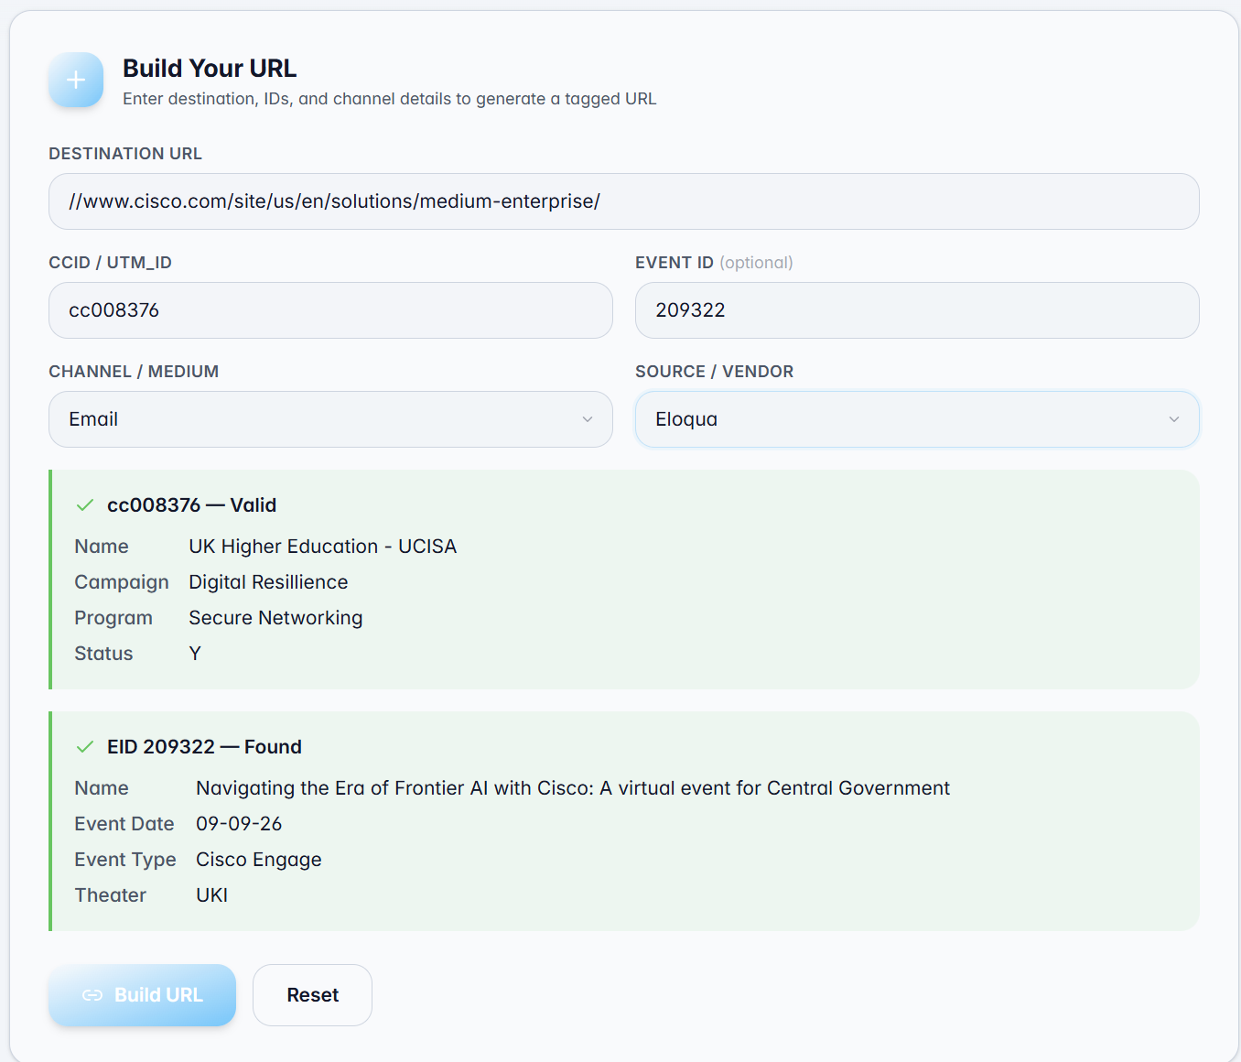
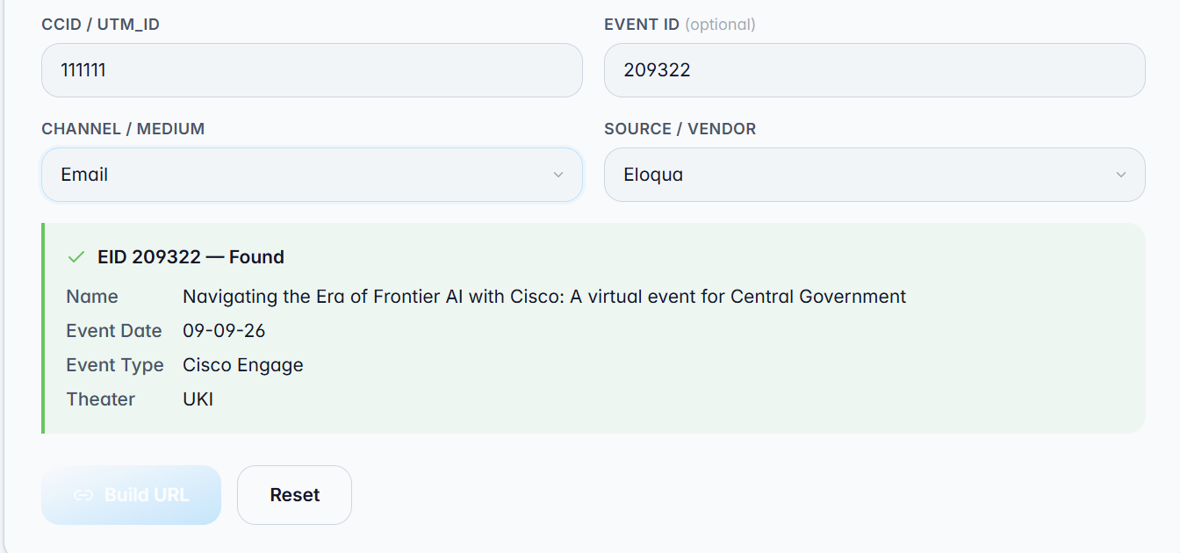
Simple URL
Layout is for Organic Social, Content Syndication, Ratings & Reviews, Paid Search and Email
1
Enter your destination URL, Activity ID (CCID) and Event ID
1
2
Activity ID and Event ID are validated automatically. Please review your selection for accuracy before proceeding
2
4
3
The Build URL button will remain disabled until a valid Activity ID is selected
3
4
Once your Activity ID (and optional Event ID) are validated, click Build URL.
N.B. Direct Mail and Organic Web Referral is not supported in the first release
3

Slide 40
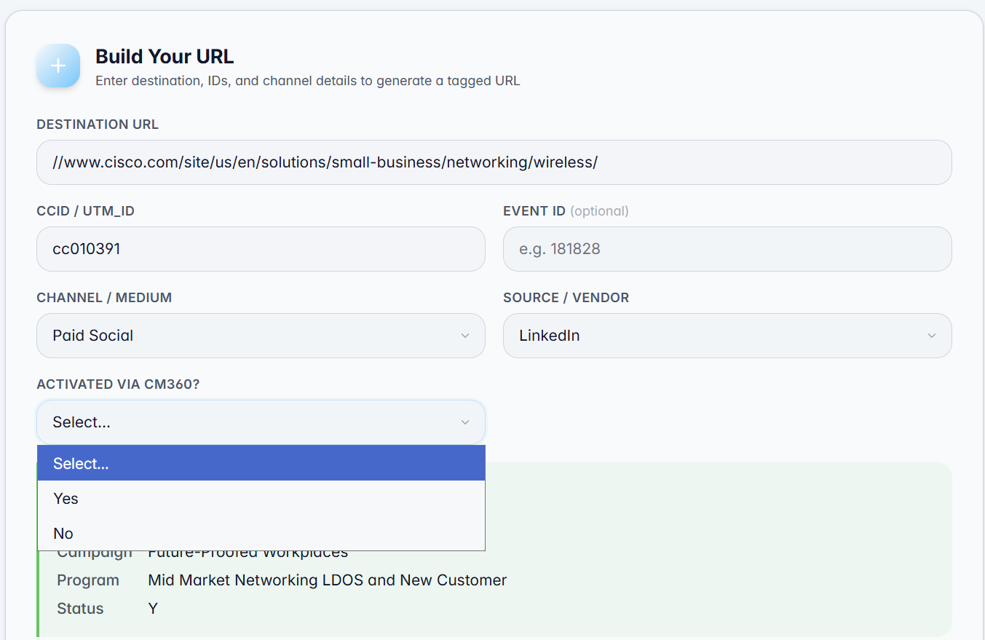
Paid Social URL
For Paid Social, you will be asked "Activated by CM360?". Select Yes if you are utilizing CM360 to host ad creative, serve digital ads, and track overall campaign performance and impressions.
1
1
Selecting Yes automatically appends the utm_creative=%ecid! parameter to your URL to enable dynamic Campaign Manager creative tracking.
2
https://www.cisco.com/site/us/en/solutions/small-business/networking/wireless/?ccid=cc010391&dtid=ppdllin001650&utm_id=cc010391&utm_medium=paid-social&utm_source=linkedin&utm_creative=%ecid!
Teams outside Global Media generally do not use CM360, so No should be selected and the utm_creative parameter will be omitted.
2
3
3
https://www.cisco.com/site/us/en/solutions/small-business/networking/wireless/?ccid=cc010391&dtid=ppdllin001650&utm_id=cc010391&utm_medium=paid-social&utm_source=linkedin

Slide 41
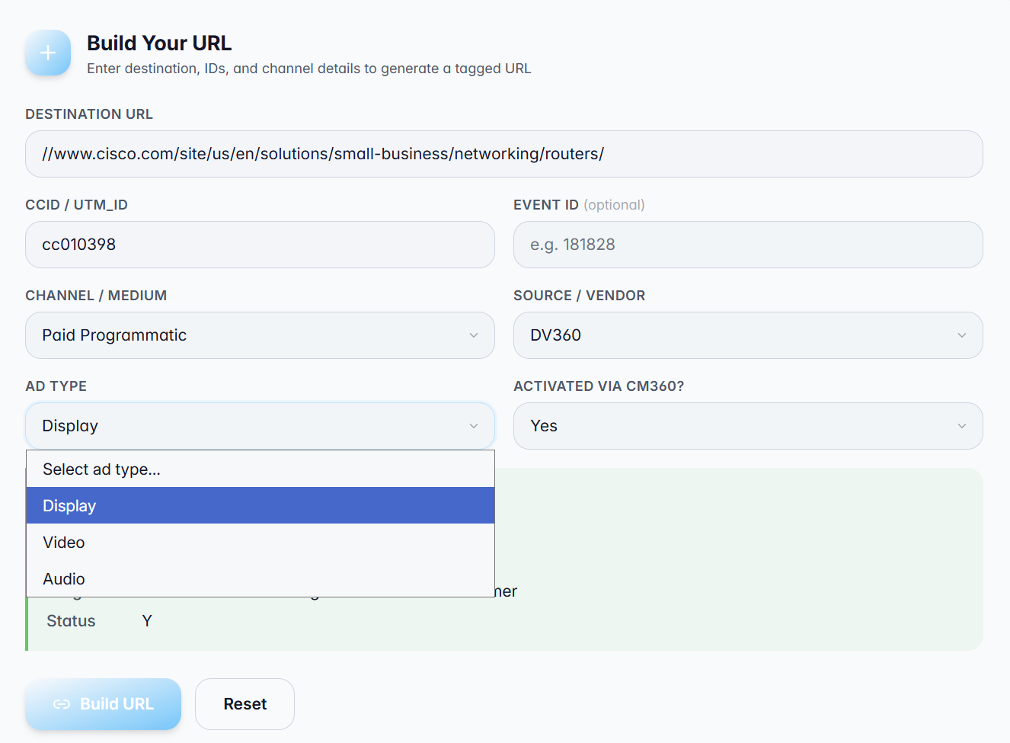
Paid Direct & Programmatic URL
Layout is for Paid Direct and Paid Programmatic
Selecting Paid Direct or Paid Programmatic triggers a follow-up question requiring you to specify the ad format as either Video, Display, or Audio..
1
2
For Paid Social, you will be asked "Activated by CM360?". Select Yes if you are utilizing CM360 to host ad creative, serve digital ads, and track overall campaign performance and impressions.
1
2
Selecting a specific ad type assigns the corresponding Drive To ID to your URL. This ensures downstream analytics and dashboards can easily isolate performance by media channel (Video, Display, or Audio).
https://www.cisco.com/site/us/en/solutions/small-business/networking/routers/?ccid=cc010398&dtid=pddpxsp001644&utm_id=cc010398&utm_medium=programmatic&utm_source=dv360&utm_creative=%ecid!
3
3
https://www.cisco.com/site/us/en/solutions/small-business/networking/routers/?ccid=cc010398&dtid=pdvpxsp001645&utm_id=cc010398&utm_medium=programmatic&utm_source=dv360&utm_creative=%ecid!

Slide 42
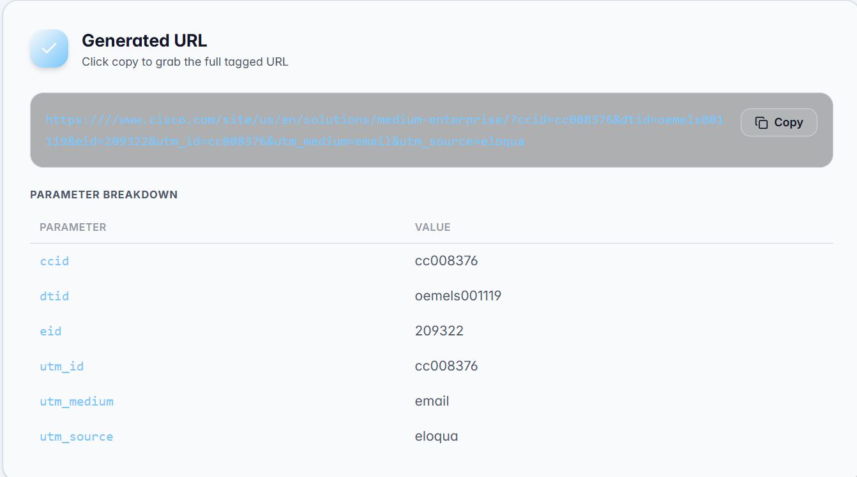
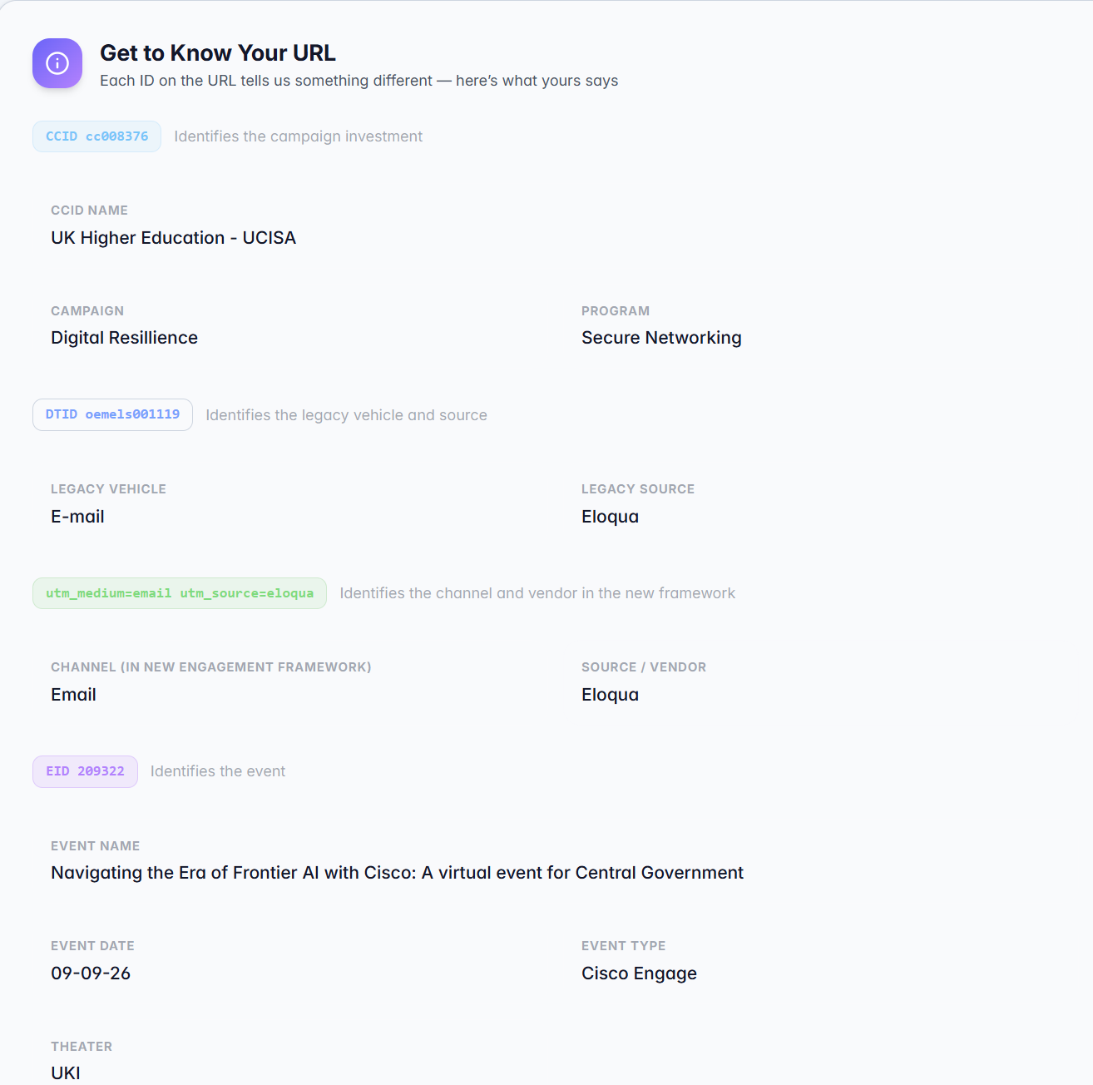
Generated URL
1
Your URL has been generated in the required format. Click the Copy icon to copy it to your clipboard.
1
2
Review the parameter summary. If updates are needed, select the Reset button to clear the fields and try again.
2
1
https://www.cisco.com/site/us/en/solutions/medium-enterprise/?ccid=cc008376&dtid=oemels001119&eid=209322&utm_id=cc008376&utm_medium=email&utm_source=eloqua
The summary section confirms the exact Campaign, Program, Channel, and Vendor/Platform that this URL will attribute to in the Marketing Sales Pipeline (MSP). All customer touchpoints driven by this URL will credit value to these specific parameters in standard MSP reporting.
3
3

Slide 43
Thank You

